Slide 1
Wild-GS: Real-Time Novel View Synthesis from Unconstrained Photo Collections
Wild-GS is trying to solve one main problem:
How can we reconstruct a realistic 3D scene from tourist photographs taken under different lighting conditions, with different cameras, and with temporary objects appearing in the images — without the high computational cost of NeRF?

Slide 2

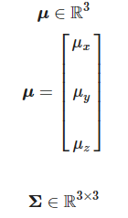
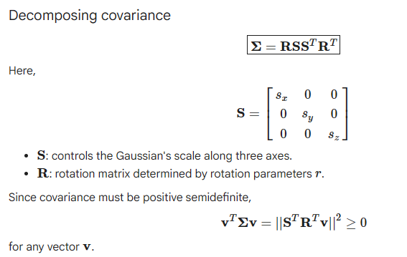
The 3D Gaussian density at a point x is
Center:

Slide 3
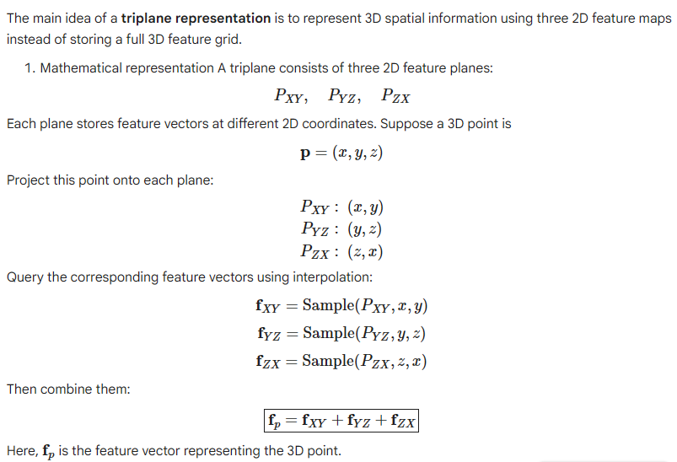
Densification and pruning

Slide 4
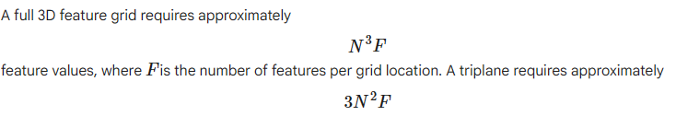
Wild-GS aims to make 3D Gaussian Splatting robust to changing appearances and transient objects in tourist photographs while retaining fast training and rendering.
1. 2D Parsing Module: Processes reference images to extract global appearance information and predict masks that identify static scene regions while excluding transient objects.
2. 3D Wrapping Module: Maps 3D Gaussian positions to local appearance embeddings using triplane features, associating detailed image appearance with the corresponding 3D locations.
3. Fusion Network: Combines global appearance embeddings, local appearance embeddings, and intrinsic Gaussian features to predict adaptive spherical harmonic (SH) coefficients for each Gaussian, enabling appropriate color rendering under different viewing conditions.

Slide 5



Hierarchical Appearance Modeling
Global appearance embedding
This represents scene-wide appearance information for a reference view, such as illumination level and tone mapping.
Local appearance embedding
This represents the local, position-dependent appearance of Gaussian i , including variations in local reflectance.
Two Gaussians in the same scene can have different local embeddings because they correspond to different surfaces or locations.
Intrinsic feature
This stores inherent attributes associated with the material or dominant region represented by Gaussian i .
For example, it may help distinguish the appearance characteristics of stone from those of glass.
The exact physical meaning of these learned features depends on how the network is trained; they are not necessarily direct measurements of real-world material properties.

Slide 6




Concatenate the three components
Pass the combined feature through the fusion network

Slide 7
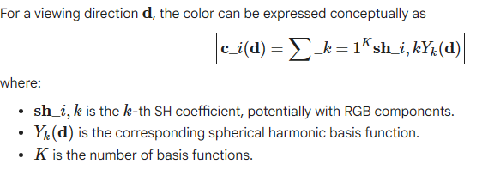
The output is not necessarily a single RGB color. It is a set of SH coefficients used to calculate the Gaussian's view-dependent color.

Slide 8
It establishes a spatial correspondence between image appearance and 3D Gaussians.
Instead of applying the same appearance adjustment to the entire scene,
Wild-GS can adapt the appearance of individual regions, preserving fine details such as local shadows, highlights, and texture variations.

Slide 9
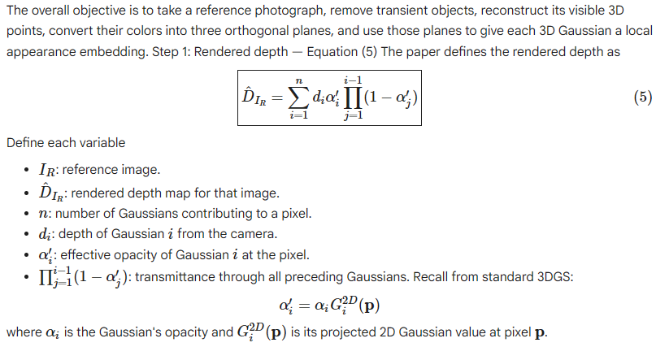
Local Appearance Control — Triplane Color Creation

Slide 10
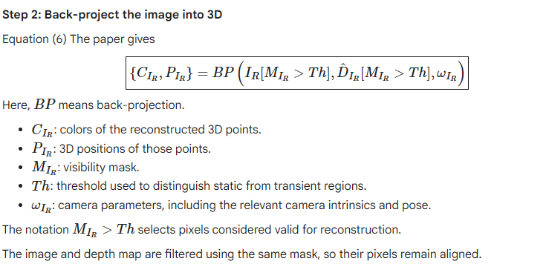

Slide 11
Why the visibility mask matters:
if a tourist covers a building in the reference image, the corresponding pixels should not be treated as reliable samples of the permanent scene.
The mask excludes those pixels before back-projection.
One important detail: back-projection reconstructs the visible surface using the estimated depth. It does not recover hidden surfaces that the camera cannot see.

Slide 12
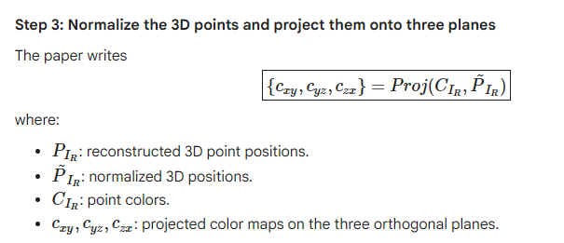

Slide 13
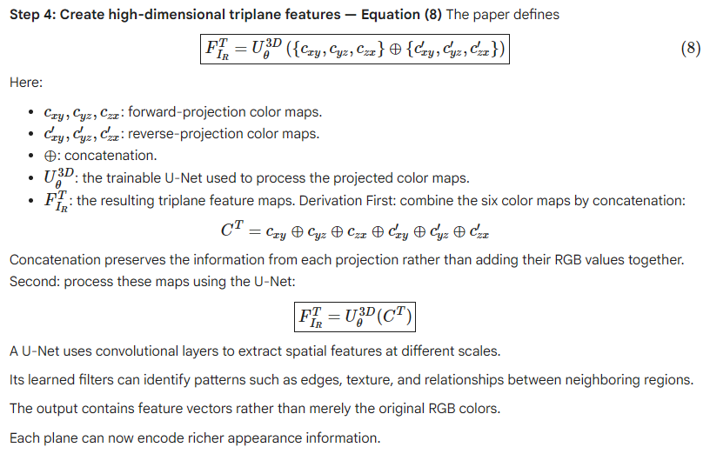

Slide 14
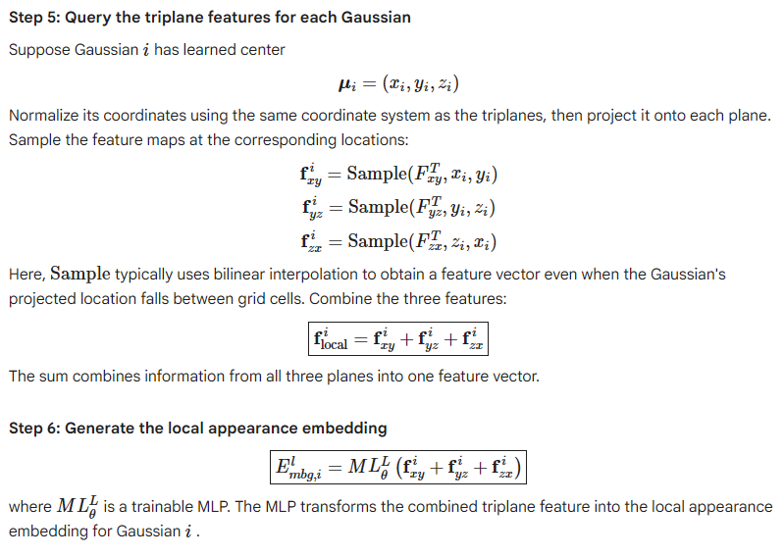

Slide 15

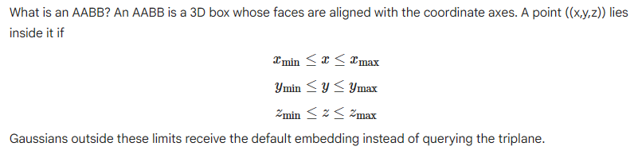
Efficient Triplane Sampling.
computational problem: high-resolution triplane feature maps are expensive to sample, but most 3D Gaussians occupy only a small region of those maps.
Find the region containing most Gaussians. Use an axis-aligned bounding box (AABB), defined by minimum and maximum coordinates along X, Y, and Z.
Restrict triplane sampling to that region. Instead of allocating sampling resources across the entire spatial extent, Wild-GS focuses on the region where Gaussians are concentrated. This improves feature-map utilization and reduces sampling costs.
Handle Gaussians outside the box. Rather than sampling the triplane, assign those Gaussians a shared learnable embedding vector, :

Slide 16
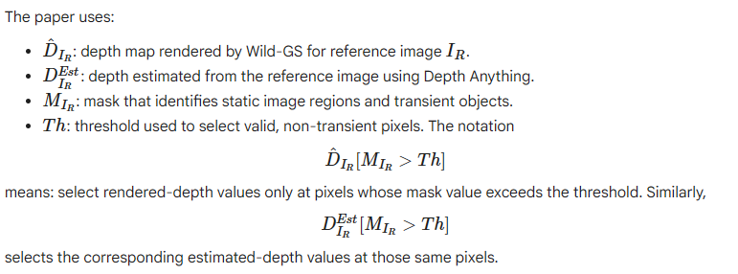
Depth Regularization

Slide 17
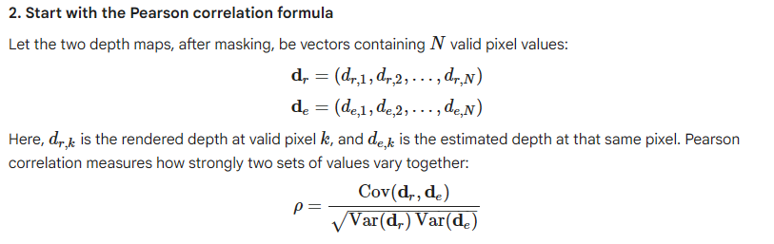
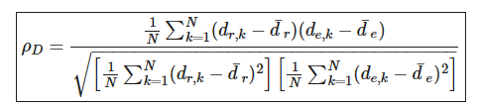

Slide 18

The equation you pasted is Pearson correlation, not a conventional minimization loss by itself.
  If the training objective maximizes this correlation, higher is better.
  If the training objective minimizes a loss, the corresponding expression would typically be:

Slide 19
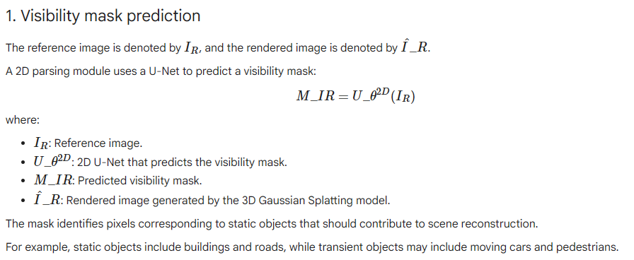
Handling Transient Objects

Slide 20
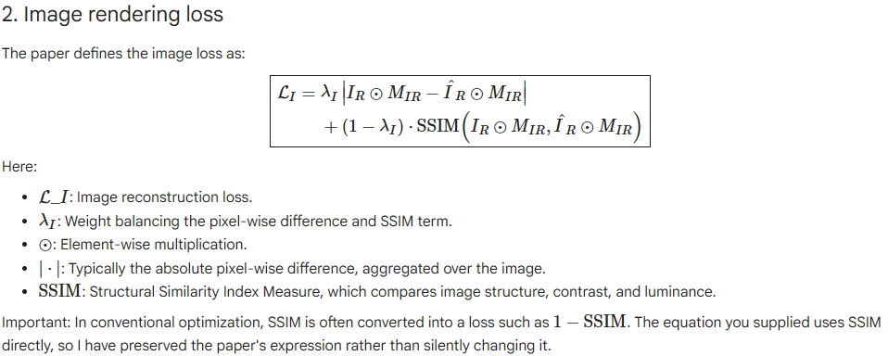

Slide 21
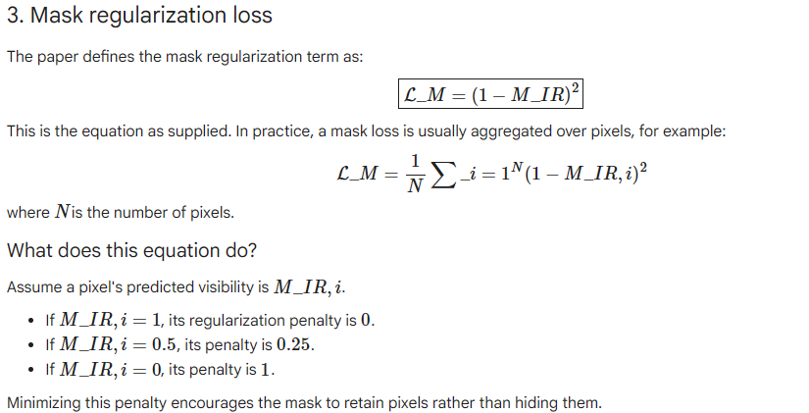

Slide 22
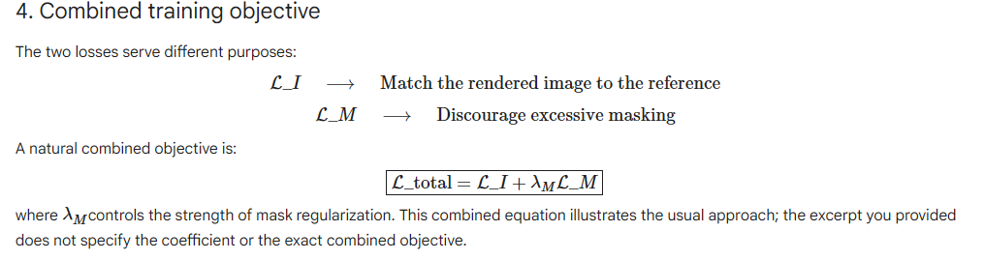
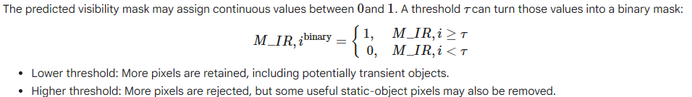

Slide 23
Ablation study: What happens when components are removed?
An ablation study removes one component at a time to test its contribution.
A. Remove depth regularization
Observed problem: missing or incorrect geometry Depth regularization constrains the depth map so that back-projected reference pixels align with the correct 3D regions.
Without it, the local appearance features may be associated with incorrectly positioned Gaussians.
B. Remove the transient mask
Observed problem: ghosting and color inconsistencies
People and other temporary objects may appear at different positions in different photographs.
Without the mask, their pixels can contaminate scene reconstruction and appearance features.
Result: ghost-like objects and inconsistent colors, particularly in regions heavily occluded by transient objects.
C. Remove global appearance encoding
Observed problem: weak global color-tone transfer
The local triplane already captures substantial appearance information for the reference viewpoint. Therefore, removing the global embedding may not cause a large reduction in ordinary image-quality metrics.
However, the model struggles to transfer a coherent global color tone to another viewpoint or appearance condition.

Slide 24
